Slide 1
How to best use these slides…
View the PPT as a slide show
Then click through every step
Mouse clicks will advance the slide show
Left/right arrow keys move forward/backward
Mouse wheel scrolling moves forward/backward
When a question is posed, stop and think it through, try to answer it yourself before clicking
If you have questions, use PS discussion boards, email me, and/or visit us in a Teams class session!

Slide 2
LESSON 7.2c
Graphing Other Rational Functions

Slide 3
Today you will:
Graph rational functions in the form $y=\frac{ax+b}{cx+d}$.
Practice using English to describe math processes and equations

Slide 4
Core Vocabulary:
Rational function, p. 366
Previous:
Domain
Range
Hyperbola
Asymptote

Slide 5
Let’s look at more complicated rational functions
$$y=\frac{ax+b}{cx+d}$$
Important note:
First question: what is the domain of a function in this form?
Asked a different way, are there any limitations or illegal $x$ values?
Hint: is there a limitation that every fraction has?
Answer: Yes! You cannot divide by zero.
That means $cx+d≠0$ so
So now we know the domain:
vertical asymptote is $x=−\frac{d}{c}$
… another common form for rational functions is
the equations in the numerator and in the denominator are of the same degree!
if $x=−\frac{d}{c}$ we have problems!
all real numbers except $x=−\frac{d}{c}$

Slide 6



Let’s look at more complicated rational functions … another common form for rational functions is
$$y=\frac{ax+b}{cx+d}$$
Vertical Asymptote: $x=−\frac{d}{c}$
Second question:
What is the range?
Best way to answer this question is to look at what happens to $y$ as $x$ gets *REALLY* big
For example, let’s make up a function $\left(y=\frac{5x−1}{2x+3}\right)$ and try $x=1,000,000$.
(note that $a=5, b=2$)
So as $x$ gets really big (as $x→∞$) then $y$ will approach $\frac{a}{c}$
This gives us the horizontal asymptote $y=\frac{a}{c}$
$$y=\frac{5x−1}{2x+3}$$
$$=\frac{5,000,000−1}{2,000,000+3}$$
$$=\frac{4,999,999}{2,000,003}$$
$$≈\frac{5}{2}$$
$$=\frac{a}{c}$$

Slide 7
Let’s look at more complicated rational functions … another common form for rational functions is
$$y=\frac{ax+b}{cx+d}$$
Vertical Asymptote: $x=−\frac{d}{c}$
Horizontal Asymptote: $y=\frac{a}{c}$

Slide 8

Update – how to graph rational functions
Draw the asymptotes
Plot points to the left and to the right of the vertical asymptote
Pick numbers for $x$ that are easy to calculate and to plot
If $a$ is negative,
Connect the dots
Draw the branches so they approach but do not touch the asymptotes
Function Form | Horizontal Asymptote | Vertical Asymptote
Translated form: $y=\frac{a}{x−h}+k$
$$y=k$$
$$x=h$$
In $y=\frac{ax+b}{cx+d}$ form
$$y=\frac{a}{c}$$
$$x=−\frac{d}{c}$$
In simple form: $y=\frac{a}{x}$
$x$-axis
$y$-axis
the graph will be reflected around the $x$ axis

Slide 9
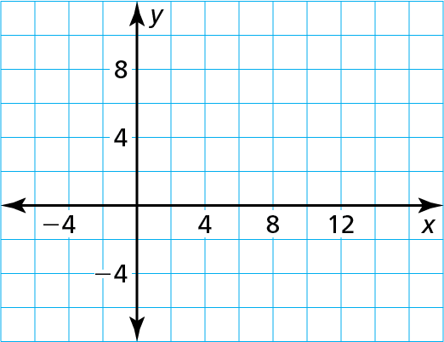
Graph f(x) $=$ $\frac{\text{2}\text{x} + \text{1}}{\text{x} − \text{3}}$. State the domain and range.
SOLUTION
Step 1 Draw the asymptotes. Solve x $−$ 3 $=$ 0 for x to find the vertical asymptote x $=$ 3. The horizontal asymptote is the line y $=$ $\frac{\text{a}}{\text{c}}$ $=$ $\frac{\text{2}}{\text{1}}$ $=$ 2
(4, 9)
Step 2 Plot points to the left of the vertical asymptote, such as (2, $−$5), $\left(\text{0}\text{,}−\frac{\text{1}}{\text{3}}\right)$ , and $\left(−\text{2}\text{, }\frac{\text{3}}{\text{5}}\right)$ . Plot points to the right of the vertical asymptote, such as (4, 9), $\left(\text{6}\text{,}\frac{\text{1}\text{3}}{\text{3}}\right)$ , and $\left(\text{8}\text{,}\frac{\text{17}}{\text{5}}\right)$.
$$\left(\text{6,}\frac{\text{13}}{\text{3}}\right)$$
$$\left(−\text{2, }\frac{\text{3}}{\text{5}}\right)$$
$$\left(\text{8,}\frac{\text{17}}{\text{5}}\right)$$
$$\left(\text{0,}−\frac{\text{1}}{\text{3}}\right)$$
(2, $−$5)
Step 3 Draw the two branches of the hyperbola so that they pass through the plotted points and approach the asymptotes.
The domain is all real numbers except 3 and the range is all real numbers
except 2.

Slide 10

Review/Recap
We now have 3 forms for Rational Functions:
Steps for graphing Rational Functions:
Draw the asymptotes
Plot points to the left and to the right of the vertical asymptote
Pick numbers for $x$ that are easy to calculate and to plot
If $a$ is negative, the graph will be reflected around the $x$-axis
Connect the dots
Draw the branches so they approach but do not touch the asymptotes
Function Form | Horizontal Asymptote | Vertical Asymptote
Translated form: $y=\frac{a}{x−h}+k$
$$y=k$$
$$x=h$$
In $y=\frac{ax+b}{cx+d}$ form
$$y=\frac{a}{c}$$
$$x=−\frac{d}{c}$$
In simple form: $y=\frac{a}{x}$
$x$-axis
$y$-axis

Slide 11
Homework
Pg 371, #25-32

